Slide 1
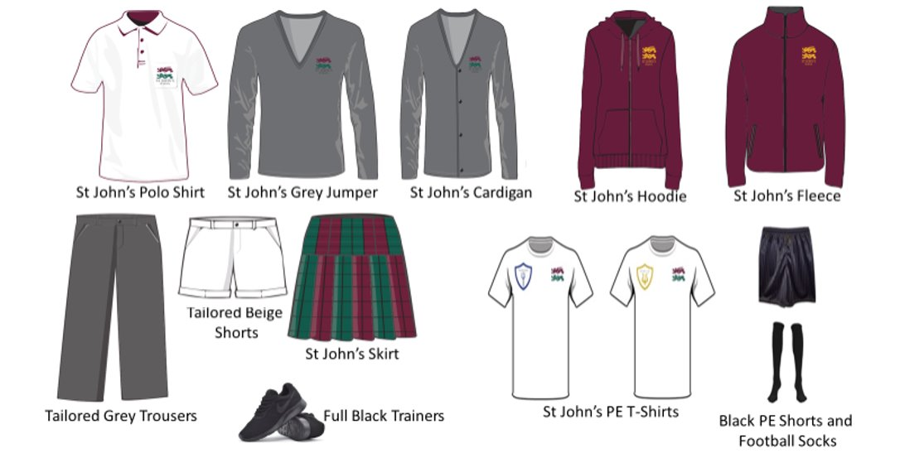
Uniform
Eliminating educational disadvantage caused by mobility

Slide 2
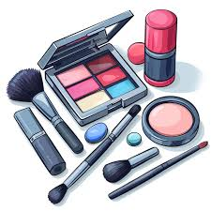
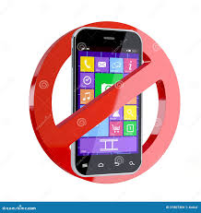
Uniform
Piercings
Small studs in nose and ears are permitted. No hoops or other facial piercings are permitted and will be expected to be removed before school.
All jewellery MUST be removed for PE with no exceptions
Shoes and Socks
Black, white, or grey socks and black shoes/trainers are allowed. Coloured of patterned socks are not to be worn. Shoes/trainers should be fully black with no variation in colour.
Nails
Natural coloured, short nails are permitted. No coloured nail varnish or long nail extensions are allowed for school.
Hair & Make-Up
Simple make-up and subtle tones are allowed.
Natural looking eyelashes are permitted. Extreme hair colours or styles are not allowed in school.
Other Jewellery
Only a watch can be worn for school.
All other bracelets, wristbands, rings and necklaces should be removed to prevent loss or injury.
Smart watches can be worn but must not cause a distraction.
Phones
Mobile phones should not be seen in school. If students have them in their bags, they should be switched off. They should only be seen in lessons as a learning tool.
Eliminating educational disadvantage caused by mobility

